Slide 1
BANK MANAGEMENT SYSYEM
MADE BY:
ISHA RATHI 111903037
KIMAYA ABHYANKAR 111903041
MIHIR MALANI 111903046

Slide 2
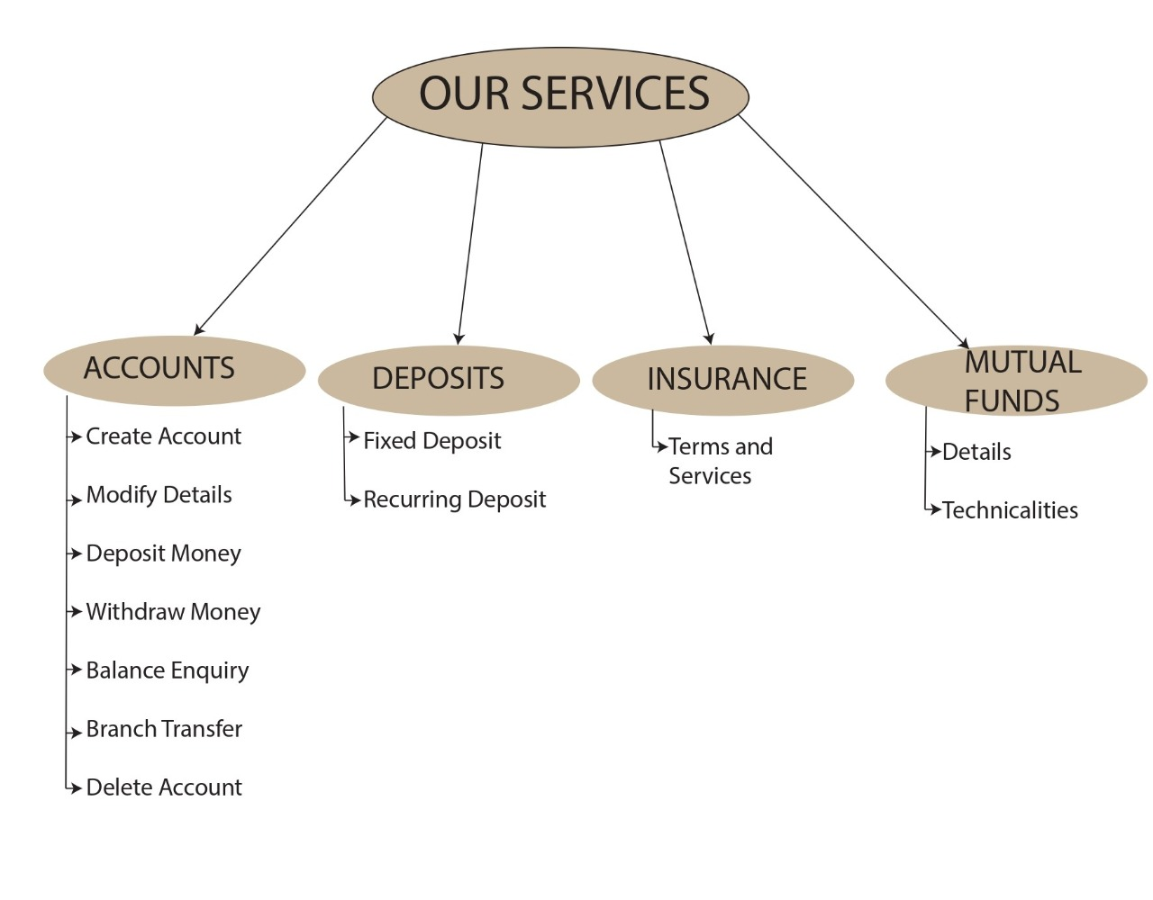
FEATURES COVERED

Slide 3
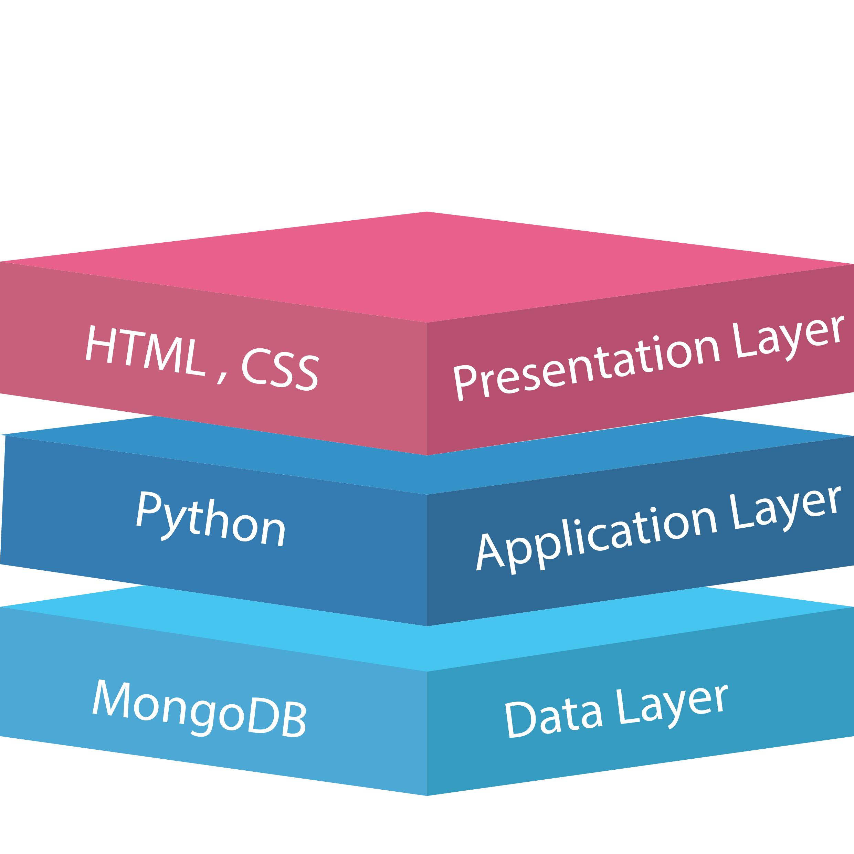
3-TIER ARCHITECTURE

Slide 4
FRONT END HTML AND CSS
The Hyper Text Markup Language, or HTML is the standard markup Language for documents designed to be displayed in a Web Browser . It can be assisted by technologies such as Cascading Style Sheets(CSS).
HTML describes the structure of a web page semantically and originally included cues for the appearance of the document.
Cascading Style Sheets (CSS) is a style sheet language used for describing the presentation of a document written in a markup language such as HTML.
CSS is designed to enable the separation of presentation and content, including layout , colors and fonts. This separation can improve content accessibility provide more flexibility and control in the specification of presentation

Slide 5
DATA MANAGEMENT MongoDB
MongoDB is a cross-platform, document oriented database that provides, high performance, high availability, and easy scalability. MongoDB works on concept of collection and document.
MongoDB is a document database in which one collection holds different documents. Number of fields, content and size of the document can differ from one document to another.

Slide 6
BACK END PROGRAMMING CONCEPTS
Inheritance
Inheritance is a mechanism in which one class acquires the property of another class.
Parent-Child Hierarchy used in defining the functions
Data Encapsulation
Data encapsulation, also known as data hiding, is the mechanism whereby the implementation details of a class are kept hidden from the user. The user can only perform a restricted set of operations on the hidden members of the class by executing special functions commonly called methods. Here the user only enters the details without actually knowing how it works
Exception Handling
Exception handling is the process of responding to the occurrence of exceptions – anomalous or exceptional conditions requiring special processing – during the execution of a program. For this project cases like date, amount, Gender , Mobile Number etc are handled.
Flask
Flask is a web framework that provides libraries to build lightweight web applications in python.

Slide 7
REFERENCES
FRONT END WEB DEVELPOMENT : W3schools.com
DATA MANAGEMENT :Tutorialspoint.com, W3Schools.com and MongoDB.com
BACK END PROGRAMMING :
Python Concepts: Python.org and StackOverflow.com
FLASK(Linking back end with frontend): Javapoint.com

